Slide 1
Be Happier

Slide 2
Emotional Contagion

Slide 3
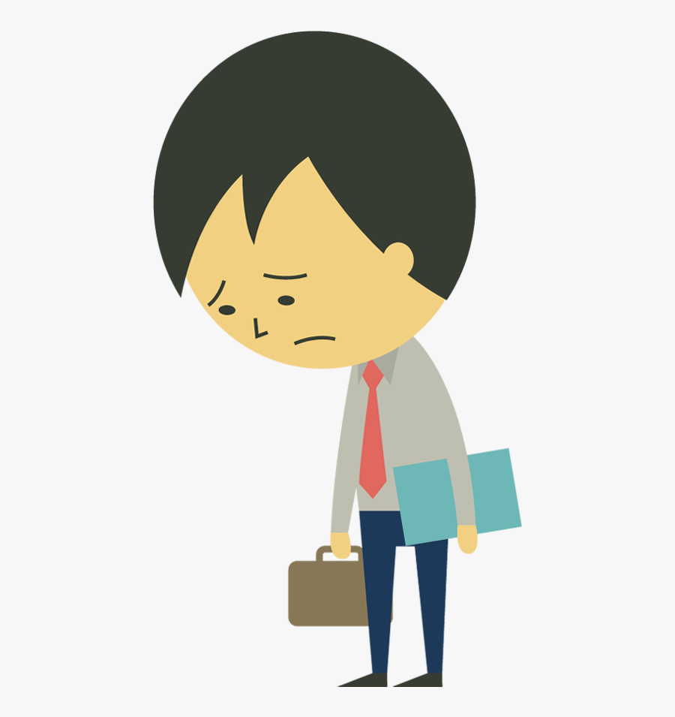
Example: In work,
Emotions of customers and employees may influence each other.
Customer satisfaction
Stuck in an emotional cycle
Notes:
https://doi-org.ezproxy.library.uvic.ca/10.1177/1094670519835309
https://www.clipartkey.com/view/owhwbR_unhappy-businessman-hanging-his-sad-businessman-cartoon-png/

Slide 4
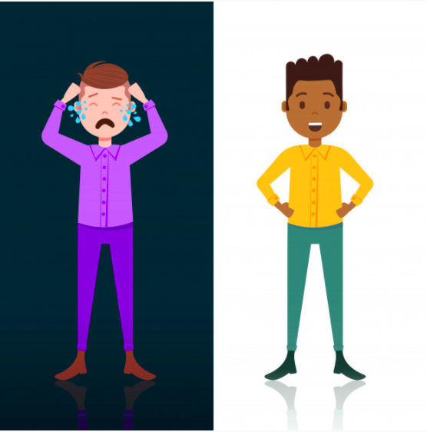
How to be happier?
Do Exercise
Talk with friend
Change environment
Notes:
https://br.freepik.com/vetores-premium/chorando-e-homem-feliz-personagem-branco-escuro-lado-misturam-corrida-modelo-masculino-para-trabalho-de-design-e-animacao-comprimento-total-vertical-plano_7222693.htm#page=1&query=animation%20tired%20work&position=1

Slide 5
Try physical exercise. Research shows that exercising three times a week for 30 to 40 minutes "is equivalent to some of our most powerful psychiatric drugs in dealing with depression or sadness or anxiety."
Notes:
https://link.gale.com/apps/doc/A238430439/ITBC?u=uvictoria&sid=ITBC&xid=bebef3f2
https://www.pinterest.ca/pin/262405115775382818/

Slide 6
The emotional issue needs an emotional therapy.

Slide 7
Travel is a good way to release your pressure.
Notes:
https://favpng.com/png_view/cartoon-travel-animation-cartoon-travel-clip-art-png/g3ssrTLW#

Slide 8
Thanks for watching

